Slide 1
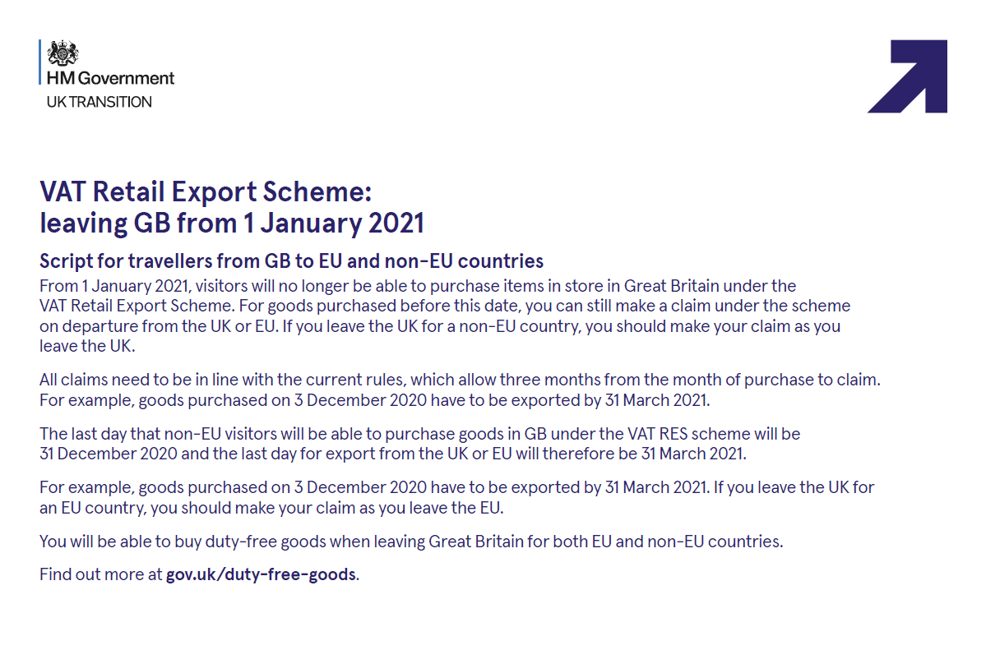

Slide 2
Tax Free Shopping – FAQ’s
When is the current tax free shopping scheme ending?
The current VAT Retail Export Scheme ends on the 31st December 2020 at 11pm for all eligible customers.
Will retailers still be able to issue Tax Free forms?
Yes, providing that the customer is eligible for Tax free Shopping retailers can continue to issue forms on goods sold up to and including the 31st December 2020.
Can a customer making a purchase in December, but not travelling until January 2021, still benefit from Tax Free shopping under the current scheme?
Yes, so long as the date of sale is on or before the 31st December 2020, customers still have the normal ‘month of sale, plus 3 months’ period to export their goods. A customer would have until the 31st March 2021 to export goods purchased in December 2020.
A customer forgot to ask for a Tax Free Form, can I issue a form in 2021?
Yes, you can, but only if the goods were bought on or before the 31st December 2020 and if a dated sales receipt was issued against the goods. Tax Free forms can be issued up until the 31st March 2021 only for purchases with receipts made on or before 31st December 2020.
Can a new Tax Free form be issued to a customer who wishes to return an item sold in December 2020, but still has other items from the same sale they wish to claim the tax back for?
Yes, provided that the original Tax Free shopping form has not been refunded, a new Tax Free form can be issued for the remaining items up until the 31st March 2021 (provided the original sale was before the end of 2020).

Slide 3
Tax Free Shopping – FAQ’s
Will UK Customs continue to stamp Tax Free Forms in 2021?
Yes, providing that the goods have been bought before the 1st of January 2021 and that the goods are exported to outside the EU by the end of March.
Will customers be able to get their Tax Free form stamped by Customs when leaving via an EU country in 2021?
EU Customs will continue to stamp UK issued forms up to the end of March 2021 providing that the goods were sold before the 1st January 2021.
Will customers be able to get a cash / credit card refunds when they leave the UK to a non-EU destination?
Yes, customers will be able to get immediate refunds up to the end of March at Heathrow, Gatwick and Manchester airports. For all other UK departure points, customers should deposit their completed Tax Free forms into the Customs Drop-Box and await a credit card refund.
Will customers be able to get a cash / credit card refunds when they leave via the EU?
Yes, customers will be able to get refunds up to the end of March where facilities are available. For details, please ask customers to visit the applicable Tax Free agent’s website.
What Tax Free option will be available from the 1st January 2021?
Tax Free shopping is available for goods purchased in the UK but goods purchased will need to be sent directly from the retailer to your overseas address, including addresses in the EU. Find out more at gov.uk/duty-free-goods.

